Slide 1
Treatment sequencing in RAS wt mCRC:
A focus on the later line
Dr. Abdulrazak-Nweir
Medical oncologist
DEC 4, 2025

Slide 2
Contents
1. Early-line sequencing
2. Later-line sequencing
3.Summary

Slide 3
Treatment sequencing
Determining the optimal treatment sequence from 1L ➔ 2L ➔ 3L and beyond is important for patients with
RAS wt mCRC, for whom multiple treatment options are available across lines¹
In particular, the 1L treatment decision is key as the proportion of patients receiving therapy falls substantially across subsequent treatment lines^{2,3}
Lines of therapy received for patients with mCRC in US medical oncology practice (N=1,655)³

Slide 4
What Influences Treatment Choices in mCRC?
Patient characteristics
Molecular characteristics
Prior adjuvant treatment
RAS
BRAF
Comorbidities
1L
MSI-high
HER2
Age
Performance status
2L
3L
Tumor characteristics
Patient preference
4L
Tumor burden
Resectability
Quality
of life
Toxicity
profile
Tumor location
Therapy tailored according to individual patient needs
Modified from Van Cutsem. Ann Oncol. 2016;27:1386.
Notes:
mCRC, metastatic colorectal cancer; MSI, microsatellite instability.

Slide 5
Evidence supports 1L anti-EGFR-based therapy followed by
2L anti-VEGF-based therapy in the treatment of LS RAS wt mCRC^{1–5}
For patients with LS RAS wt mCRC, treatment sequencing starting with 1L anti-EGFR-based therapy prior to 2L anti-VEGF-based therapy is supported by:
Biological rationale as anti-EGFR therapies directly induce cytoreduction whereas anti-VEGF therapies block tumor angiogenesis and are effective against small tumors that are actively growing and vascularizing⁵
ESMO guideline recommendations for 1L and 2L treatment^{3,4}
Meta-analysis of retrospective studies of 1L anti-EGFR therapy ➔
2L anti-VEGF therapy vs the reverse sequence¹
Phase III STRATEGIC-1 trial of multi-line treatment sequences in
RAS wt/BRAF wt mCRC²

Slide 6


There are hypothesised biological rationales for using anti-EGFR agents followed by anti-VEGF agents¹
RAS mutation¹
VEGF priming¹
Tumor vs stromal targeting^{1,2}
1L Anti-EGFR agent
1L
Anti-EGFR agent
Anti-VEGF agent
Early in tumor evolution (1L)
Tumor
Anti-EGFR agent
Tumor cells
Secondary RAS mutation to overcome EGFR inhibition
Secondary RAS mutation to overcome
hypoxia-dependent cell death
Anti-VEGF agent
Stromal cells
Rapid cytoreduction
Later in tumor evolution (2L)
Anti-EGFR agent
Tumor cells
2L
Anti-VEGF agent retains efficacy
Tumor cells resistant to anti-EGFR agent
Anti-VEGF agent
Upon later active growth/vascularization
– sensitive to 2L anti-VEGF agent
Stromal cells
Higher degree of mutation
Blood vessels
Lower degree of mutation

Slide 7
ESMO guidelines recommend 1L anti-EGFR agent + CT* and 2L anti-angiogenic agent + CT for patients with LS RAS wt mCRC¹
Recommendations differ according to primary tumor location, because tumor location has been shown to influence outcomes to targeted agents²
 | 1L | 2L
LS | Anti-EGFR agent (cetuximab or panitumumab) + doublet CT* | CT ± anti-angiogenic agent‡ In patients who have not received 1L anti-EGFR agent: Anti-EGFR agent (cetuximab or panitumumab) + FOLFIRI or irinotecan
RS | Doublet/triplet CT† ± bevacizumab When cytoreduction is the goal: Anti-EGFR agent (cetuximab or panitumumab) + doublet CT* | CT ± anti-angiogenic agent‡

Slide 8
A previous meta-analysis supported a sequence of 1L anti-EGFR agent + CT* followed by 2L anti-VEGF agent + CT*¹
Meta analysis of retrospective studies in KRAS wt† mCRC: OS¹
Hazard ratio
Hazard ratio
Study or Subgroup†
Log (hazard ratio)
SE
Weight
IV (random, 95% CI)
IV (random, 95% CI)
Buchler et al, 2019
-0.1165
0.1894
21.6%
0.89 (0.61, 1.29)
Deng et al, 2015
0
0
Not estimable
Hsu et al, 2019
-0.6349
0.2265
15.4%
0.53 (0.34, 0.83)
Modest et al, 2015
-0.3567
0.123
47.0%
0.70 (0.55, 0.89)
Peeters et al, 2017
-0.4308
0.2228
15.9%
0.65 (0.42, 1.01)
Total (95% CI)
100.0%
0.70 (0.58, 0.83)
Heterogeneity: Tau²=0.00; Chi²=3.23, df=3 (p=0.36); I²=7%
Test for overall effect: Z=3.94 (p<0.0001)
0.01
0.1
1
10
100
Favors
1L anti-EGFR + CT*
Favors
1L anti-VEGF + CT
2L anti-VEGF + CT
2L anti-EGFR + CT*

Slide 9
STRATEGIC-1 was the first Phase III trial to prospectively compare multi-line treatment sequences in RAS wt mCRC^{1,2}
1L
2L
3L
Continuous cetuximab + FOLFIRI (n=131)
Bevacizumab + FOLFOX
Patients with previously untreated, unresectable
RAS wt BRAF wt mCRC* (N=424)†
Arm A
R
Continuous bevacizumab + OPTIMOX (stop-and-go oxaliplatin) (n=132)
Bevacizumab + FOLFIRI
Cetuximab ± irinotecan or panitumumab
Arm B
Primary endpoint: DDC‡
(combined PFS across all treatment lines received)
STRATEGIC-1 was designed to evaluate the superiority of Arm B vs Arm A: Targeted HR of 0.67
Limitations of comparability between arms:
different dosing strategies, CT backbones, and number of treatment lines
*RAS/BRAF mutational status could be pending at time of randomization, provided it was obtained within the first two cycles of 1L therapy; †Of the 424 patients who were randomized, 263 patients underwent population analysis while 161 patients either dropped out, did not have RAS wt or BRAF wt status, or their RAS or BRAF status was not known after two cycles of 1L therapy; ‡The STRATEGIC-1 study did not meet its primary endpoint; mDDC was similar between arms.
(m)DDC, (median) duration of disease control; HR, hazard ratio; PFS, progression-free survival; R, randomization.
1. Chibaudel B, et al. ASCO 2022 (Abstract No. 3504 – presentation); 2. Chibaudel B, et al. BMC Cancer 2015;15:496.

Slide 10
STRATEGIC-1: Results supported a sequence of 1L cetuximab + CT* followed by 2L bevacizumab + CT^{†1}
DDC (primary endpoint)
Secondary endpoints
1.0
Arm A (1L cetuximab + FOLFIRI):
mDDC, 22.5 months (95% CI 20.1–27.1)
Outcome | Arm A (1L cetuximab + FOLFIRI) | Arm B (1L bevacizumab + OPTIMOX) | HR/OS (95% CI) | p value
1L ORR | 82.4% | 69.7% | NR | p<0.001
2L ORR | 21.2% | 18.3% | NR | p=0.734
3L ORR |  | 14.6% | NR | NA
mOS, months | 37.8 | 34.4 | 1.26 (0.94–1.70) | p=0.121
Arm B (1L bevacizumab + OPTIMOX):
mDDC, 23.5 months (95% CI 17.9–26.2)
0.8
HR, 0.97 (95% CI 0.72–1.29);
p=0.805
0.6
DDC event-free
survival probability
0.4
0.2
0.0
0
6
12
18
24
30
36
42
Time since the start of the first treatment sequence (months)
STRATEGIC-1 did not meet its primary endpoint;
mDDC was similar between arms despite fewer lines of therapy in Arm A¹
1L cetuximab + CT* ➔ 2L bevacizumab + CT led to
higher ORR and numerically longer mOS
vs 1L/2L bevacizumab + CT^{†1}

Slide 11
There may be benefit to stop-and-go vs continuous anti-EGFR administration before further lines of treatment¹
Phase II IMPROVE trial¹
PD
PD
Arm A (n=69)
1L
2L
Patients with unresectable and previously untreated RAS wt BRAF wt mCRC (N=137)
Panitumumab + FOLFIRI
2L treatment
Primary endpoint:
PFS at 1 year
R
1:1
Pani + FOLFIRI
(up to 8 cycles)
Treatment-free
interval
Pani + FOLFIRI
(up to 8 cycles)
Treatment-free
interval
Arm B (n=68)
Strategy repeated until progression on treatment, unacceptable toxicity, or withdrawal of consent²
1.0
PFS_{OT}¹
Continuous panitumumab + FOLFIRI (n=69)
Stop-and-go panitumumab + FOLFIRI (n=68)
mPFS_{OT,}
months
0.8
Events
95% CI
12-month rate
52
13.2
9.6–16.8
60.8%
41
17.1
9.3–24.9
0.6
52.1%
PFS_{OT}
Primary endpoint met with 34 patients alive and without PD at 1 year in the stop-and-go arm
The ongoing OPTIPRIME trial is further investigating a stop-and-go panitumumab + FOLFOX strategy with fluoropyrimidine maintenance³
0.4
0.2
0.0
0
6
12
18
24
30
36
Time (months)

Slide 12
Later-line sequencing
2

Slide 13

What is the 3rd line treatment goal?
Extending
survival
Disease
control
Maintain QOL

Slide 14
BEYOND 2NDLINE WHAT WE HAVE ?
REGORAFENIB.
TAS-102.
COMBINATION (REG+NIVO, TAS+BEVA).
RECHALLENG WITH TARGET OR CHEMOTHERAPY.
CLINICAL TRIALs .

Slide 15
Current ESMO guidelines for 3L and beyond include many treatment options but offer little guidance on their selection^{1–3}
ESMO Living Guidelines v1.1 2023 recommendations for the ≥3L treatment of
RAS wt/BRAF wt mCRC¹
TAS-102 + bevacizumab [I, A; MCBS 4]
Single-agent anti-EGFR mAb* [I, A; panitumumab MCBS 2]
Irinotecan-cetuximab* [II, B]
TAS-102 [I, A; MCBS 3]
Regorafenib [I, A; MCBS 1]
Fruquintinib is additionally recommended in ESMO pan-Asian guidelines⁴
ESMO guidelines also state: “In patients maintaining RAS wt status, rechallenge with anti-EGFR mAbs may be an option in selected patients [III, C]”³

Slide 16


The optimal sequence of agents across later lines of treatment in patients with RAS wt mCRC has not been fully established¹
Sequential treatment strategy with different therapies across each line
1L
2L
3L
4L+
Rechallenge strategy using the same therapy in 1L and a later line
1L
2L
3L
4L+
More patients are now living to receive later lines of therapy,
increasing the need for trials investigating sequencing in the 3L and beyond¹

Slide 17
CORRECT and CONCUR: Two randomized phase III trials of regorafenib in metastatic colorectal cancer (mCRC)
CORRECT was a global study conducted in Australia, Belgium, Canada, China, Czech Republic, France, Germany, Hungary, Israel, Italy, Japan, Netherlands, Spain, Switzerland, Turkey, and USA¹
CONCUR is an Asian trial conducted in China, Hong Kong, Korea, Taiwan, and Vietnam²
Regorafenib 160 mg orally once daily (3 weeks on, 1 week off)
+ best supportive care
Primary Endpoint:
Overall survival
Secondary Endpoints:
PFS, ORR, DCR, and safety
Tertiary Endpoints:
Duration of response/stable
disease, QOL, PK, biomarkers
PATIENTS (N=760)
With mCRC after standard therapy: fluoropyrimidine, oxaliplatin, irinotecan, bevacizumab, and cetuximab or panitumumab (if KRAS wild-type)
R
2:1
Placebo (3 weeks on, 1 week off)
+ best supportive care
PATIENTS (N=204)
With mCRC after standard therapy: fluoropyrimidine, oxaliplatin, irinotecan
Patients may have received bevacizumab, and cetuximab or panitumumab (if KRAS wild-type)
Regorafenib 160 mg orally once daily (3 weeks on, 1 week off)
+ best supportive care
Primary Endpoint:
Overall survival
Secondary Endpoints:
PFS, ORR, DCR, and safety
Tertiary Endpoints:
Duration of response/stable disease, QOL, PK, biomarkers
R
2:1
Placebo (3 weeks on, 1 week off)
+ best supportive care
1. Grothey A, et al Lancet 2013;381:303–312; 2. Li J, et al Lancet Oncol 2015;16:619–629

Slide 18
Other guideline-recommended later-line agents, such as regorafenib, have shown efficacy vs placebo, but with limited benefit¹
Phase III CORRECT trial
OS¹
Other outcomes¹
100
Regorafenib 160 mg (n=505):
mOS 6.4 months (95% CI 3.6–11.8)
 | Regorafenib | Placebo | p-value
ORR, % | n=505 | n=255 | 0.19
ORR, % | 1.0 | 0.4 | 0.19
mPFS, months (IQR) HR (95% CI) | n=505 | n=255 | <0.0001
mPFS, months (IQR) HR (95% CI) | 1.9 (1.6–3.9) | 1.7 (1.4–1.9) | <0.0001
 | 0.49 (0.42–0.58) |  | p<0.001
90
80
Placebo (n=255):
mOS 5.0 months (95% CI 2.8–10.4)
70
60
HR 0.77 (95% CI, 0.64–0.94)
p=0.0052
50
OS (%)
40
30
20
10
0
0
2
4
6
8
10
12
14
Months since randomization
Survival benefits vs placebo were preserved in the KRAS wt population¹
OS HR (95% CI) regorafenib vs placebo: 0.65 (0.48–0.90)
PFS HR (95% CI) regorafenib vs placebo: 0.48 (0.36–0.62)

Slide 19
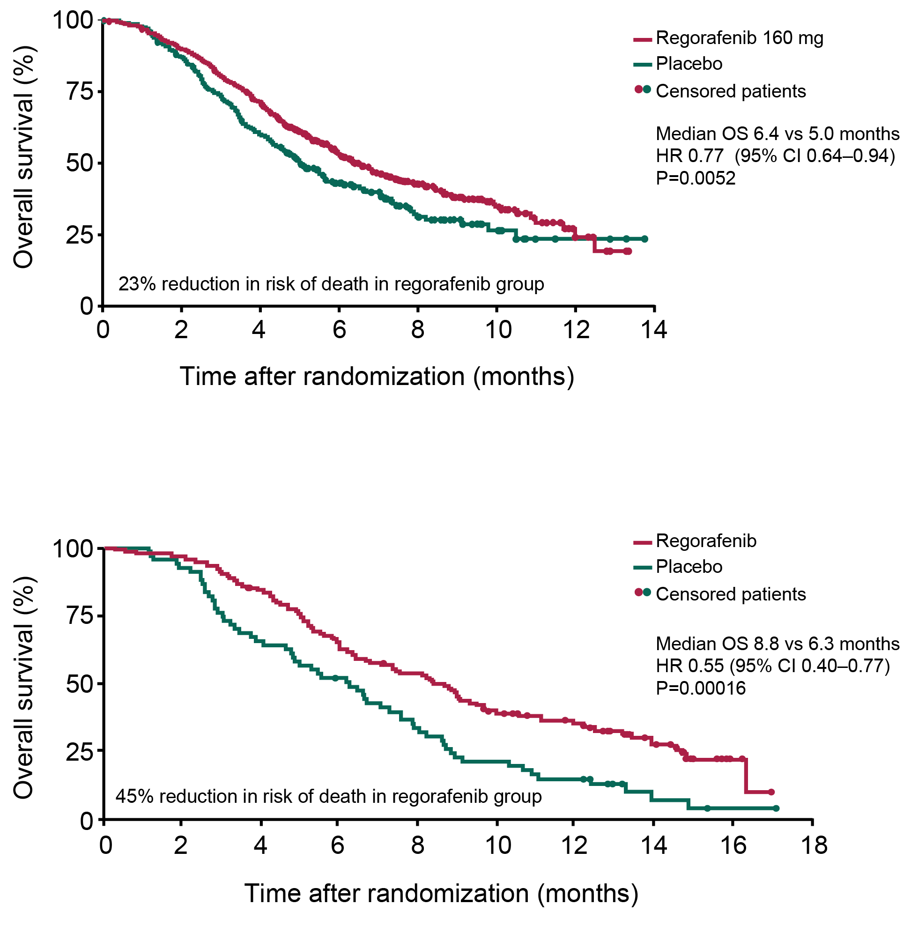
CORRECT & CONCUR: OS (primary endpoint)
CORRECT
CONCUR
CI, confidence interval.
1. Grothey A, et al Lancet 2013;381:303–312; 2. Li J, et al Lancet Oncol 2015;16:619–629

Slide 20
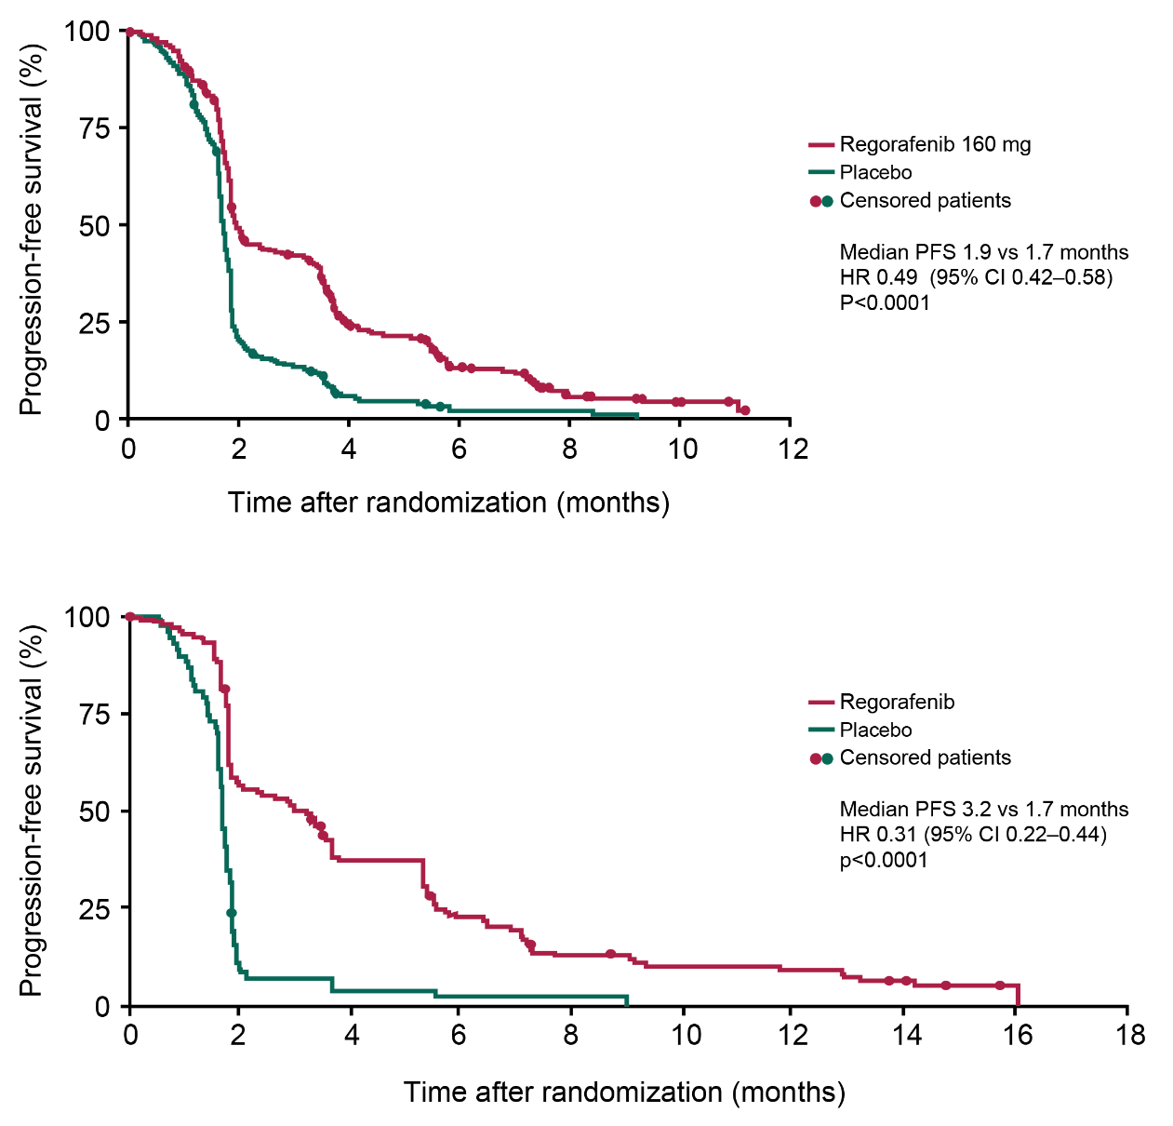
CORRECT & CONCUR: PFS (secondary endpoint)
CORRECT
CONCUR
CI, confidence interval.
1. Grothey A, et al Lancet 2013;381:303–312; 2. Li J, et al Lancet Oncol 2015;16:619–629

Slide 21
CORRECT & CONCUR: Secondary endpoints
 | CORRECT |  | CONCUR
 | REGORAFENIB (N=505) | PLACEBO (N=255) | REGORAFENIB (N=136) | PLACEBO (N=68)
PFS, Median, months | 1.9 | 1.7 | 3.2 | 1.7
HR (95% CI) P-value | 0.49 (0.42–0.58) <0.0001 |  | 0.31 (0.22–0.44) <0.0001
CR, n (%) | 0 | 0 | 0 | 0
PR, n (%) | 5 (1) | 1 (<1) | 6 (4) | 0
SD, n (%) | 216 (43) | 37 (15) | 62 (46) | 5 (7)
Non-CR/Non-PD*, n (%) | 4 (1) | 1 (<1) | 2 (1) | 0
DCR†, n (%) | 207 (41) | 38 (15) | 70 (51) | 5 (7)
One-sided P-value | P<0.0001 |  | P<0.0001
*Non-CR/Non-PD included in disease control rate and followed the same criteria as SD.
†CORRECT: CR or PR or SD (subjects with SD as response performed earlier than 6 weeks after randomization,
were not taken into account); CONCUR: CR or PR or SD (≥6 weeks after randomization). Both according to RECIST v1.1.
1. Grothey A, et al. Lancet. 2013;381:303–312. 2. Li J, et al. Lancet Oncol. 2015;16:619–629.

Slide 22
TAS-102 has two phase III trials in mCRC globally and Asia
RECOURSE global randomized phase III trial
Australia, Austria, Belgium, Czech Republic, France, Germany, Ireland, Italy, Japan, Spain, Sweden, United Kingdom, and United States^{1,2}
TERRA Asian randomized phase III trial
China, Korea, and Thailand³
PATIENTS (N=800)
Patients with mCRC refractory to standard chemotherapies
Patients failed at least 2 prior regimens of standard chemotherapies for mCRC
TAS-102 35 mg/m² orally BID, days 1-5 and 8-12 of each 28-day cycle
Primary Endpoint: OS
Secondary Endpoints: PFS, safety
Study Start Date: June 2012
Completion Date:
December 2016
R
2:1
Placebo orally BID, days 1-5 and
8-12 of each 28-day cycle
Results for the RECOURSE study have been published (see next slide).
PATIENTS (N=400)
Asian patients with mCRC refractory or intolerant to standard chemotherapies
Patients failed at least 2 prior regimens of standard chemotherapies for mCRC
TAS-102 35 mg/m² orally BID, days 1-5 and 8-12 of each 28-day cycle
Primary Endpoint: OS
Secondary Endpoints: PFS, safety
Study Start Date:
September 2013
Completion Date:
June 2016
R
2:1
Placebo orally BID, days 1-5 and
8-12 of each 28-day cycle
OS, overall survival; PFS, progression-free survival. 2. Mayer RJ, et al. N Eng J Med 2015;372:1909–19; 3. http://www.clinicaltrials.gov/ct2/show/NCT01955837.

Slide 23
TAS-102 has also shown efficacy vs placebo for the later-line treatment of mCRC, though again with limited benefit¹
Phase III RECOURSE trial
OS¹
Other outcomes¹
100
TAS-102 (n=534):
mOS 7.1 months (95% CI 6.5–7.8)
 | TAS-102 | Placebo | p-value
ORR, % | n=502 | n=258 | 0.29
ORR, % | 1.6 | 0.4 | 0.29
mPFS, months (95% CI) HR (95% CI) | n=534 | n=266 | <0.001
mPFS, months (95% CI) HR (95% CI) | 2.0 (1.9–2.1) | 1.7 (1.7–1.8) | <0.001
 | 0.48 (0.41–0.57) |  | p<0.001
90
80
Placebo (n=266):
mOS 5.3 months (95% CI 4.6–6.0)
70
60
HR 0.68 (95% CI, 0.58–0.81)
p<0.001
50
OS (%)
40
30
20
10
0
0
3
6
9
12
15
18
Months since randomization
Survival benefits vs placebo were preserved in the KRAS wt population¹
OS HR (95% CI) TAS-102 vs placebo: 0.58 (0.45–0.74)
PFS HR (95% CI) TAS-102 vs placebo: 0.48 (0.38–0.60)

Slide 24
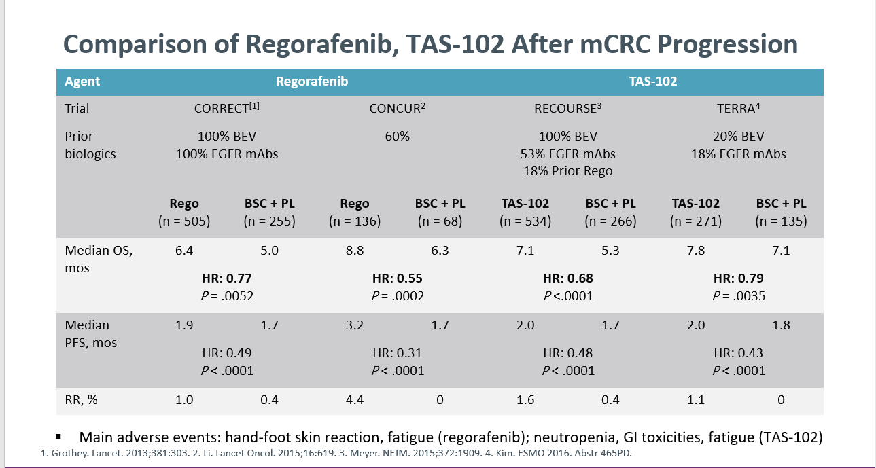

Slide 25
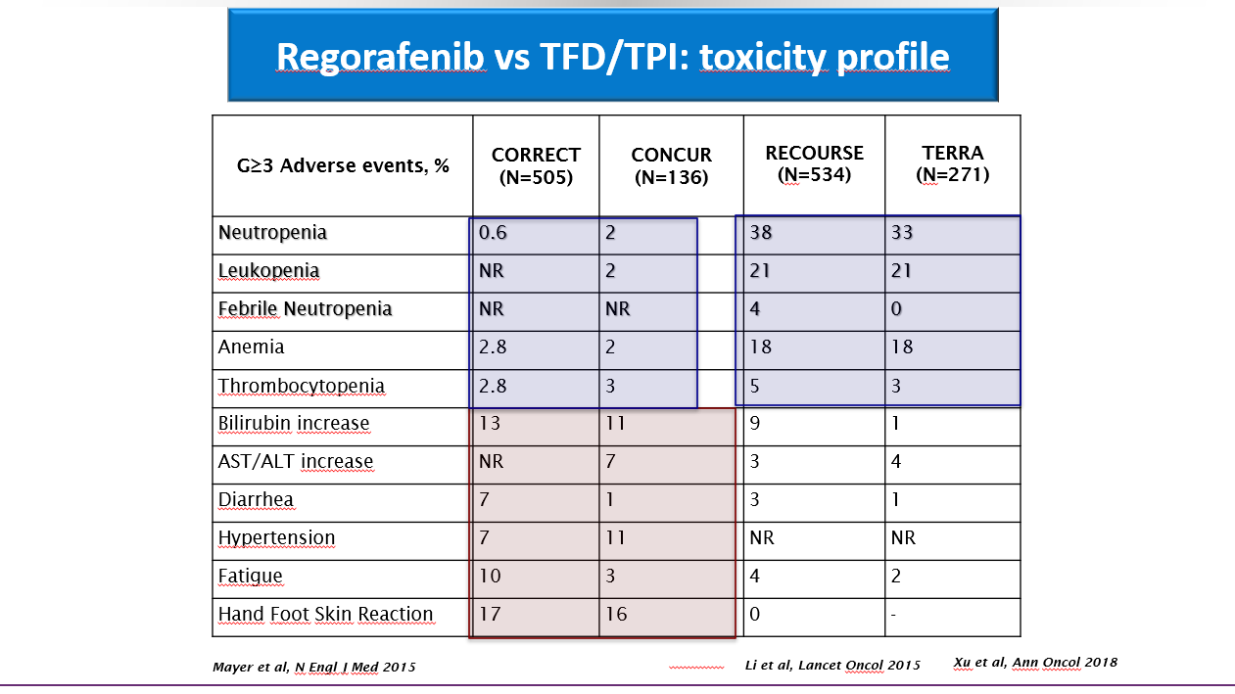

Slide 26
TAS-102 ± Bevacizumab for Patients With Chemorefractory Metastatic Colorectal Cancer (Sunlight)
Open-label, randomized phase II study
Patients with mCRC refractory or intolerant to a fluoropyrimidine, irinotecan, oxaliplatin, and cetuximab or panitumumab (if RAS wildtype),
WHO PS 0/1
(N = 93)
TAS-102 35 mg/m² PO BID, D1-5 and 8-12 Q4W
+ Bevacizumab 5 mg/kg, D1 and 15 Q4W
(n = 46)
Treat until PD, unacceptable toxicity, or pt request
TAS-102 35 mg/m² PO BID, D1-5 and 8-12 Q4W
(n = 47)
Primary endpoint: PFS;
secondary endpoints: OS, response, toxicity, tumor markers
Pfeiffer. Lancet Oncology. 2020;21:412.
Notes:
DCR, disease-control rate; DoR, duration of response; ECOG, Eastern Cooperative Oncology Group; mCRC, metastatic colorectal cancer; PD, progressive disease; PS, performance status; TTF, time to treatment failure; WT, wild type.

Slide 27
Bevacizumab + TAS-102 provided OS benefit vs TAS-102 alone in ≥3L mCRC in the SUNLIGHT trial*¹
OS (primary endpoint)¹
100
TAS–102 + bevacizumab (n=246):
mOS 10.8 months (95% CI 9.4–11.8)
Results from SUNLIGHT may position bevacizumab + TAS-102 as a standard of care in the 3L^{2,3}
The majority of patients treated with bevacizumab + TAS-102 had RAS mt disease (69.5%) and so would have been ineligible for anti-EGFR rechallenge^{1,4}
80
TAS–102 (n=246):
mOS 7.5 months (95% CI 6.3–8.6)
HR 0.61 (95% CI 0.49–0.77)
p<0.001
60
Survival probability (%)
40
20
0
0
1
2
3
4
5
6
7
8
9
10
11
12
13
14
15
16
17
18
19
20
Months
Outcome¹ | TAS–102 + bevacizumab (n=246) | TAS–102 (n=246) | HR/OR (95% CI) | p value
PFS, months (95% CI) | 5.6 (4.5–5.9) | 2.4 (2.1–3.2) | 0.44 (0.36–0.54) | <0.001
ORR, % (95% CI) | 6.1 (3.5–9.9) | 1.2 (0.3–3.5) | NR | NR

Slide 28
Fruquintinib + BSC showed efficacy vs placebo + BSC as a later-line treatment option in the global Phase III FRESCO-2 trial¹
OS (primary endpoint)¹
Fruquintinib is a selective tyrosine kinase inhibitor targeting VEGFRs 1, 2 and 3
1.0
Fruquintinib + BSC (n=461):
mOS 7.4 months (95% CI 6.7–8.2)
0.8
Placebo (n=230):
mOS 4.8 months (95% CI 4.0–5.8)
0.6
Stratified HR 0.66
(95% CI, 0.55–0.80)
Stratified p<0.0001
Probability of OS (%)
The majority of patients treated with fruquintinib (73%) had received
>3 prior lines of therapy*¹
0.4
0.2
Fruquintinib + BSC (n=461)
Placebo + BSC (n=230)
0
0
1
2
3
4
5
6
7
8
9
10
11
12
13
14
15
16
17
18
19
Time since randomization (months)
 | Fruquintinib + BSC (n=461) | Placebo + BSC (n=230) | Adjusted difference (95% CI); p-value
ORR, n (%) | 7 (2) | 0 (0) | 2 (0.4–2.7); p=0.059
DCR, n (%) | 256 (56) | 37 (16) | 39.4 (32.8–46.0); p<0.0001
mPFS, months (95% CI) | 3.7 (3.5–3.8) | 1.8 (1.8–1.9) | Stratified HR: 0.32 (0.27–0.39); p<0.0001

Slide 29
Re-challenge background
Patients who experience progression on cetuximab plus chemotherapy but have maintained RAS wt tumour status may benefit from continuation of cetuximab with a chemotherapy backbone switch because they have probably developed resistance to the chemotherapeutic agents rather than the biologic component of the regimen.
Conversely, patients whose disease progresses on cetuximab-based therapy due to drug-selected clonal expansion of RAS-mutant tumour cells may regain sensitivity to cetuximab following a defined break from anti-EGFR therapy. Looking to the future, RAS status determination at disease progression by liquid, needle or excisional biopsy may identify patients eligible for cetuximab continuation and rechallenge.
With this approach, treatment benefit can be extended, adding to established continuum-of-care strategies in patients with mCRC.

Slide 30
The Santini hypothesis explains the biological rationale of anti-EGFR rechallenge¹
1L
2L
≥3L
Anti-EGFR agent* + CT
Anti-EGFR agent-free interval
Anti-EGFR agent* rechallenge + CT
Tumor
shrinkage
PD
Tumor
shrinkage
PD
Tumor
shrinkage
Anti-EGFR agent-sensitive clone
Resistance is predominantly driven
by acquired mutations in RAS and EGFR ectodomain clones^{2–4}
RAS mt EGFR mt alleles decline upon
anti-EGFR agent withdrawal, leading the tumor to regain sensitivity^{5,6}
Anti-EGFR agent-resistant clone
Rechallenge is now recommended as an option in the ESMO guidelines for patients maintaining RAS wt status²

Slide 31
A range of Phase II studies have investigated anti-EGFR rechallenge^{1–11}
Phase II studies | N | Patient population | Rechallenge therapy
Santini et al. 2012¹ | 39 | KRAS codons 12–13 wt* | Cetuximab + irinotecan-based therapy
CRICKET^{†2} | 28 | RAS wt BRAF wt | Cetuximab† + irinotecan
CAVE^{‡3} | 77 | RAS wt | Cetuximab‡ + avelumab
JACCRO CC-08⁴ | 34 | KRAS exon 2 wt* | Cetuximab + irinotecan
E-Rechallenge^{5,6} | 33 | RAS wt | Cetuximab + irinotecan
WJOG8916G⁷ | 56 | RAS wt | Cetuximab§ + TAS-102
Sorah et al. 2022⁸ | 10 | KRAS exon 2 wt* | Cetuximab¶ and palbociclib
JACCRO CC-09⁹ | 25 | KRAS exon 2 wt* | Panitumumab + irinotecan
CHRONOS¹⁰ | 27 | RAS wt BRAF wt EGFR-ECD wt | Panitumumab
VELO¹¹ | 62 | RAS wt | Panitumumab + TAS-102 vs TAS-102 alone
The CRICKET and CHRONOS studies provided initial evidence regarding the role of
anti-EGFR rechallenge in patients maintaining RAS wt mCRC at rechallenge baseline^{†2,10}

Slide 32
Starting with Erbitux + CT* in 1L enables rechallenge in later lines: Rechallenge with Erbitux® + CT* has demonstrated effective disease control in patients with RAS wt mCRC^{1,2}
DCR in Phase II prospective rechallenge studies with Erbitux + CT*
Santini:
KRAS wt mCRC†
(n=39)¹
CRICKET:
RAS wt mCRC‡
(n=28)²
90%
95% CI: NR
54%
95% CI:
36–70%
9.8 months mOS
*Irinotecan-based CT; †Erbitux® is approved in patients with EGFR-expressing, RAS wt mCRC: in combination with irinotecan-based CT, or in 1L in combination with FOLFOX, or as a single agent in patients who have failed oxaliplatin- and irinotecan-based therapy and who are intolerant to irinotecan;^{3 ‡}Patients received Erbitux® every other week while the Erbitux® EU SmPC states Erbitux® is administered once a week.³
Santini D, et al. Ann Oncol 2012;23:2313–2318;
Cremolini C, et al. JAMA Oncol 2019;5:343–350;
Erbitux SmPC, June 2014;

Slide 33
The CRICKET trial provides evidence of the efficacy of cetuximab + irinotecan rechallenge in the 3L¹
Liquid biopsy at baseline to determine ctDNA RAS status
Phase II trial design¹
CRICKET
Patients with
RAS/BRAF wt* mCRC
Cetuximab† + FOLFIRI/FOLFOXIRI
Bevacizumab + FOLFOX/FOLFOXIRI/XELOX
500 mg/m² Q2W cetuximab† rechallenge + irinotecan (N=28)
Primary endpoint: ORR
PFS¹
OS¹
Primary endpoint met:
ORR of 21%
(95% CI: 10–40%)¹
RAS wt ctDNA (n=13): mPFS, 4.0 months
RAS mt* ctDNA (n=12): mPFS, 1.9 months
HR: 0.44 (95% CI: 0.18–0.98); p=0.03
RAS wt ctDNA (n=13): mOS, 12.5 months
RAS mt* ctDNA (n=12): mOS, 5.2 months
HR: 0.58 (95% CI: 0.22–1.52); p=0.24
100
100
80
80
60
60
PFS probability (%)
OS probability (%)
40
40
20
20
0
0
0
2
4
6
8
10
12
14
0
5
10
15
20
Follow-up (months)
Follow-up (months)

Slide 34
Retrospective analysis suggests that anti-EGFR agents may offer greater PFS and OS compared with regorafenib or trifluridine/tipiracil in 3L treatment of LS RAS wt mCRC*¹
Retrospective analysis of 3L anti-EGFR based treatment compared with regorafenib or trifluridine/tipiracil in patients with LS RAS wt mCRC
PFS in LS RAS wt mCRC
OS in LS RAS wt mCRC
100
Anti-EGFR based treatment (n=30) Regorafenib or trifluridine/tipiracil (n=27)
100
Anti-EGFR based treatment (n=30)
75
75
Regorafenib or trifluridine/tipiracil (n=27)
PFS
50
7.3 mPFS
OS
50
15.2 mOS
25
3.6 mPFS
25
11.0 mOS
0
8
Months
0
18
Months
0
2
4
6
10
12
14
16
0
6
12
24
30
36
HR (95% CI) 0.47 (0.26–0.85) p=0.003
HR (95% CI) 0.58 (0.31–1.08) p=0.043
In a rechallenge setting, Erbitux can provide an additional line of treatment before moving onto regorafenib or trifluridine/tipiracil
Figures adapted from Vivolo R, et al. ASCO 2020 (Abstract No. 4082).
*Erbitux® is approved in patients with EGFR-expressing, RAS wt mCRC: in combination with irinotecan-based CT, or in 1L in combination with FOLFOX, or as a single agent in patients who have failed oxaliplatin- and irinotecan-based therapy and who are intolerant to irinotecan.
1. Vivolo R, et al. ASCO 2020 (Abstract No. 4082 – poster).

Slide 35
Erbitux rechallenge has demonstrated a manageable safety profile with no unexpected adverse events¹
Erbitux + irinotecan rechallenge
(CRICKET trial; n=28)¹
Regorafenib*
(CORRECT trial; n=500)²
TAS-102*
(RECOURSE trial; n=533)³
Grade 3/4 AEs | Patients, n (%)
Diarrhea | 5 (18)
Acneiform rash | 4 (14)
Neutropenia | 4 (14)
Hand-foot syndrome | 2 (7)
Patients, %
Patients, %
Cremolini et Al, Jama Oncol 2018
Grothey A, et al. Lancet 2013;381:303–312.
Mayer RJ, et al. N Engl J Med 2015;372:1909–1919.

Slide 36
New recommendations for ctDNA testing prior to anti-EGFR rechallenge^{1,2}
Correctly validated and sensitive ctDNA assays have the ability to identify mutations to direct targeted cancer therapy, and can be used when tissue biopsy is unavailable or inappropriate^{1,2}
The ESMO Precision Medicine Working Group reviewed the use of ctDNA assays in patients with cancer¹
The 2023 CRC ESMO and 2023 ESMO
Pan-Asian consensus guidelines provide a new recommendation for assessment of RAS mutation status^{2,3}
Recommendation: Before anti-EGFR rechallenge, longitudinal KRAS/NRAS and EGFR-ECD ctDNA tests should be performed [II, B]¹
Recommendation: Use of liquid biopsy to determine RAS
mutation status when no tumor sample is available [II,B]^{2,3}
Pascual D, et al. Ann Oncol 2022;33:750–768;
Cervantes A, et al. Ann Oncol 2023;34:10–32;

Slide 38


There is yet to be Phase III data for anti-EGFR rechallenge; what do we currently know about how it fits into the treatment sequence?
Treating with a 1L anti-EGFR agent enables anti-EGFR rechallenge to be an option in the 3L¹
Data from CRICKET has shown the potential benefits of 3L rechallenge in a small population, particularly for those maintaining RAS wt status at rechallenge baseline²
There is a lack of completed prospective trials in the 3L and beyond to help inform sequencing of rechallenge vs other agents

Slide 39




Summary
A strong body of evidence supports use of 1L anti-EGFR agent ➔ 2L anti-VEGF agent for patients with LS RAS wt mCRC^{1–4}
The optimal sequencing of agents across later lines of treatment has not been fully established^{1,5}
Bevacizumab + TAS-102 and fruquinitnib have shown promise in the ≥3L setting,^{6,7} but additional head-to-head trials are needed to sequence them within the treatment landscape
ESMO guidelines and Phase II studies support anti-EGFR rechallenge as a 3L treatment option for tumors that maintain RAS wt status from 1L baseline^{1,8–11}
Starting with a 1L anti-EGFR agent enables ≥3L anti-EGFR rechallenge⁸
Ongoing trials, such as FIRE-4, PARERE, REVERCE II, and CAPRI-2-GOIM, will expand our understanding of the role of anti-EGFR rechallenge in later-line treatment sequencing^{12–15}

